Slide 1



Slide 2
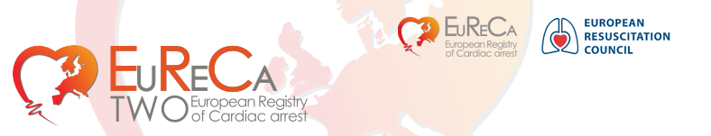
Content:
EuReCa TWO
  About the study
    I. Structure
    II. 29 Participating countries
    III. Aims
    IV. Objectives
    V. Statistical Analysis
  Timeline
  Contacts

Slide 3
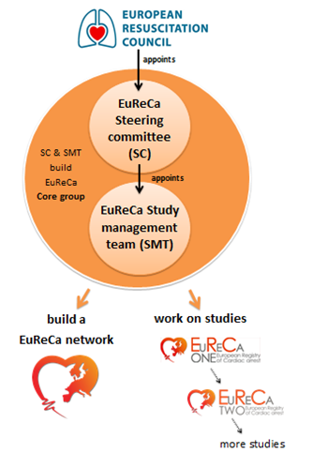
I. About the study
Structure

Slide 4
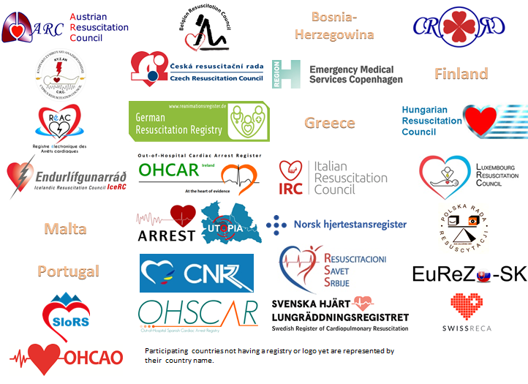
II. About the study

Slide 5
III. About the study
Aims:
Expand the EuReCa network
Find the incidence and outcome for out-of-hospital cardiac arrest (OHCA) in Europe
Improve the understanding of the role, age, and gender profile of bystanders in OHCA in Europe
Generate estimates of European OHCA incidence and outcome for patient subgroups that make up a small proportion of overall cases at national level e.g. traumatic aetiology, patients transferred to hospital with ongoing CPR.

Slide 6
IV. About the study
Objectives:
Encourage participating countries to aim for national data collection and encourage additional countries to participate
In order to provide more robust estimates of incidence, management and outcome, the period of data collection is three months (1st October to 31st December 2017)
Identify consistency and variation in the use of the term ‘bystander CPR’
Describe the incidence of ‘bystander CPR’ and its influence on OHCA outcome

Slide 7
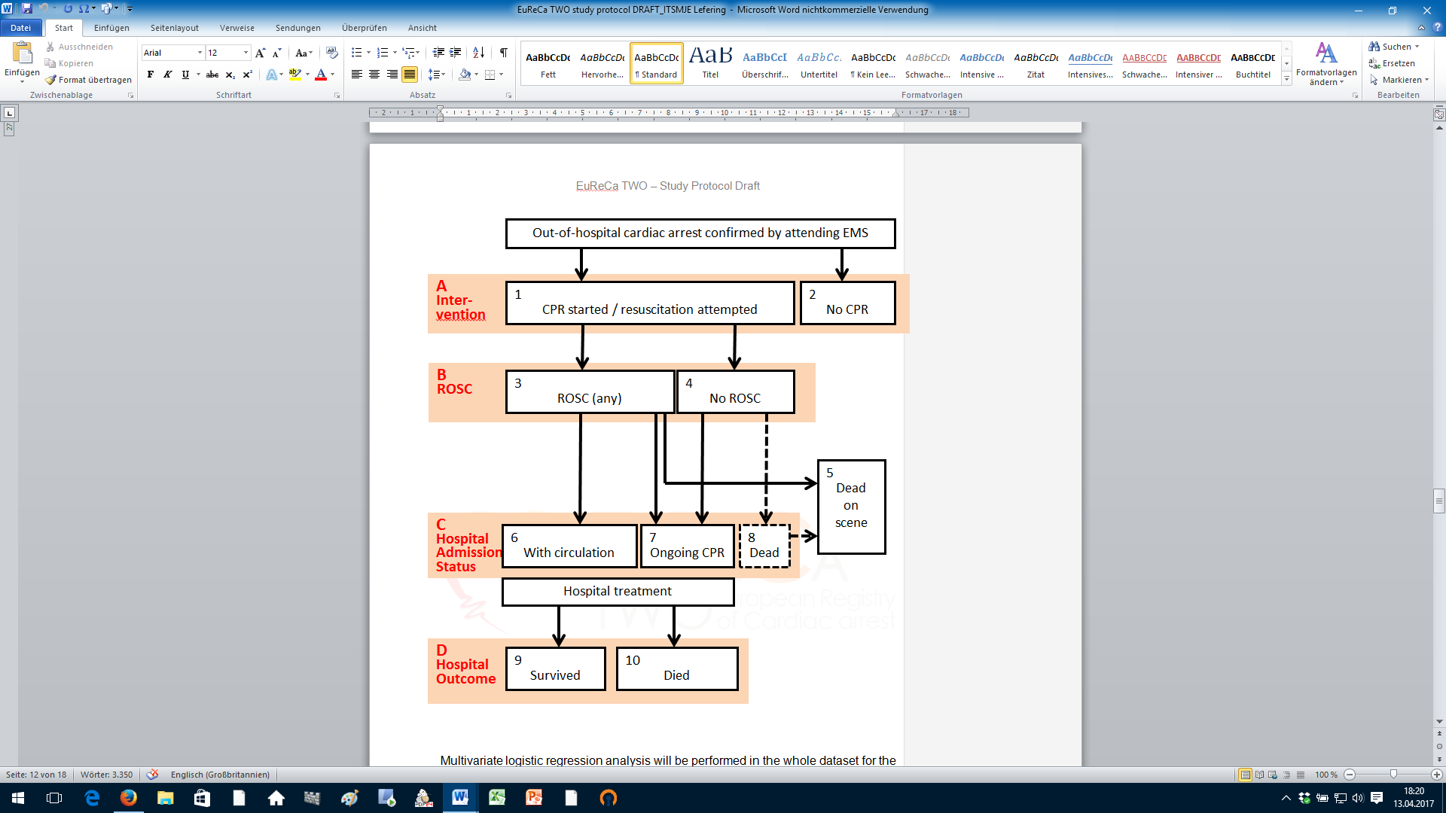
V. About the study
Statistical Analysis

Slide 8
Timeline
October 1, 2017 Study period begins, first patient in
December 31, 2017 Last patient, end of study period
January 31, 2018 Last patient in for 30-day-survival
April 2018 Last data submitted (incl. for 30-day-survival) by
national coordinator
August 2018 Analysis and first draft
October 2018 ERC meeting present preliminary results to participants
Early 2019 Publication of EuReCa TWO
March 1, 2018 Last data submitted (incl. for 30-day-survival) by
participating EMS to National coordinator

Slide 9
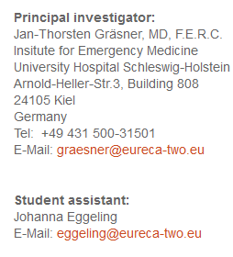
Contacts
National Coordinator :
Name:
E-Mail:

